Slide 1
SWS3009B – Tele-Robotic
Arduino Setup Guide

Slide 2
Outline
Basic Information / Facts
Arduino IDE
Programming
Blink LED
Serial Communication
Interfacing with components:
Ultrasonic Sensor
Motor
Interrupt
Motor Encoder

Slide 3
Foreword
Most of the topics were discussed and demonstrated during the 2-day lecture
Instead of asking you to keep referring to the lecture slides from those topics
I have duplicated the relevant slides here to facilitate your reading + working
Slides requires your working are marked with a red color top-right corner (like this slide!)
Green top-right corner == optional practices
So, this is now an “All in One” powerpoint ☺

Slide 4
Arduino Milestones
Ask Instructor / TA to check when you finished each task
Take time to learn and do them properly, you have ~2.5 days to do all of them ☺
Basic
C1: Serial Blink
C2: Ultra-Ultra Sonic Sensor
Motor
C3: Move Like the Real Thing
Interrupt
C4: How Far?
C5: Move with “Precision”!
C6: Obstacle Avoidance Vehicle

Slide 5
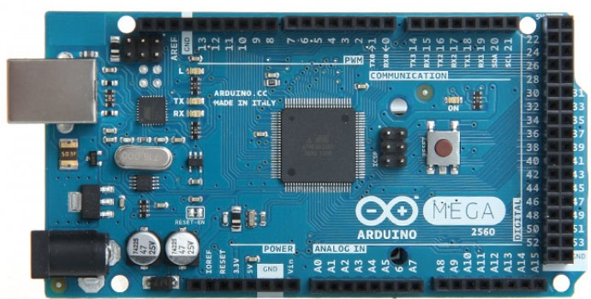
Hello Arduino!
Arduino Mega 2560 (Revision 3)
Note that the reset button is on the corner for our boards

Slide 6
Arduino Mega: Basic Facts
Microcontroller Board
Based on ATmega1280
USB connection
Alternative Powering Option: Power Jack
Input / Output Capabilities
54 digital input/output pins
14 can be used for PWM output (more later)
16 analog inputs
Digitized to 10 bits (i.e. 1024 levels)
4 UART (Serial Ports)
16MHz Crystal Oscillator (Clock Signal)

Slide 7
Setting Up Arduino IDE
Install Arduino IDE (https://www.arduino.cc/en/Main/Software) on your laptop
Plug in USB cable
Run Arduino IDE:
Set board (Tools→Board) to "Arduino/Genuino Mega or Mega 2560"
Select port (Tools→Port) to "COMX" (X is a number)
Sample Program:
Select "File→Examples→01.Basics→Blink"
Click the ➔ Button (upload) button
The LED on Arduino Mega should start blinking

Slide 8
Programming on Arduino
Programming Language:
Subset of C/C++
Limited set of C/C++ libraries
Additional set of Arduino specific calls
Online Reference at https://www.arduino.cc/en/Reference/HomePage
Program structure:
Minimally need the setup() and loop() functions
Additional functions can be declared
Global Variables
void setup()
void loop()

Slide 9
Blink: An example program
void setup() {
pinMode(13, OUTPUT);
}
void loop() {
digitalWrite(13, HIGH);
delay(1000);
digitalWrite(13, LOW);
delay(1000);
}
pinMode( pin, mode )
pin = pin number
mode = { INPUT, OUTPUT }
digitalWrite( pin, value )
pin = pin number
value = 0 / 1 (use LOW / HIGH constant!)
delay( ms )
ms = millisecond

Slide 10
O1: Let's Blink Differently
Change the blinking patterns as following:
A: Blink twice in a second
B: Blink short-short-long
C: Blink randomly
(Hint: Look for the correct library call in Arduino)

Slide 11
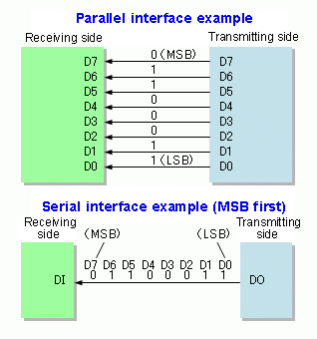
Serial Communication: Idea
Serial Communication is a very old idea
Still commonly supported:
Only need 2 wires for two way communication!

Slide 12
Serial Communication: Arduino Mega
Arduino Mega support 4 sets of serial communication (two ways each):
Serial 0: Through the USB connection or Pin 0 (Receive RX) + Pin 1 (Transmit TX)
Serial 1: Pin 19 (RX) + Pin 18 (TX),
Serial 2: Pin 17 (RX) + Pin 16 (TX)
Serial 3: Pin 15 (RX) + Pin 14 (TX)
Be careful: Check the operating voltage of the device you want to communicate with:
Arduino Mega operates at 5 volt

Slide 13
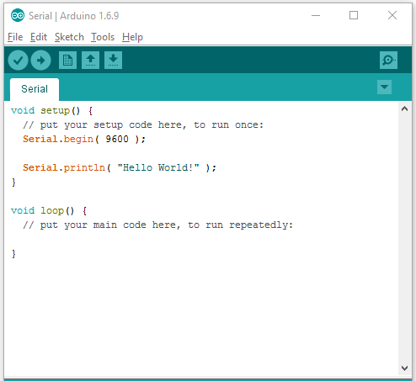
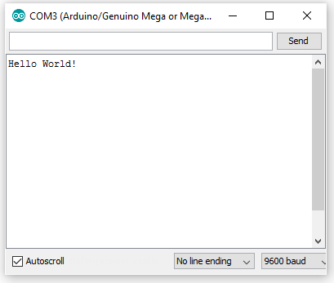
Serial Communication: Code
2. Click ( or press Ctrl-Shift-M") to open the serial monitor
1. Start a new sketch and enter the code above
3. Upload the Code to see the output message

Slide 14
Serial Communication: Code 2
void setup() {
Serial.begin( 9600 );
Serial.println( "Hello World!" );
}
void loop() {
if (Serial.available()) {
int inByte = Serial.read();
Serial.print("Read: ");
Serial.print(inByte);
Serial.print(" 0x");
Serial.println(inByte, HEX);
}
}

Slide 15
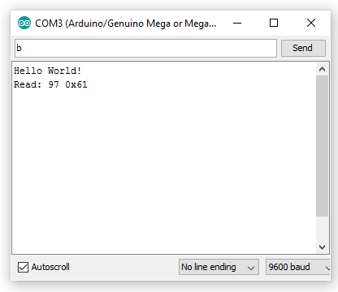
Serial Communication: Code 2
Try sending a message here
Can you figure out what did we type?

Slide 16
C1: Serial Blink
Write a program to:
Control the blink rate on the Arduino Mega
If the user enter "w", increase the blink rate (blink faster)
If the user enter "s", decrease the blink rate (blink slower)
You can set a meaningful maximum / minimum blink rate
Helpful function:
constrain( value, lowest, highest );

Slide 17
Interfacing with Components
Arduino can interface with many electronic components
Common steps:
Connect the electronic components to the correct pin(s)
Write code to interact with the component:
Sometimes, libraries are provided together with the components

Slide 18
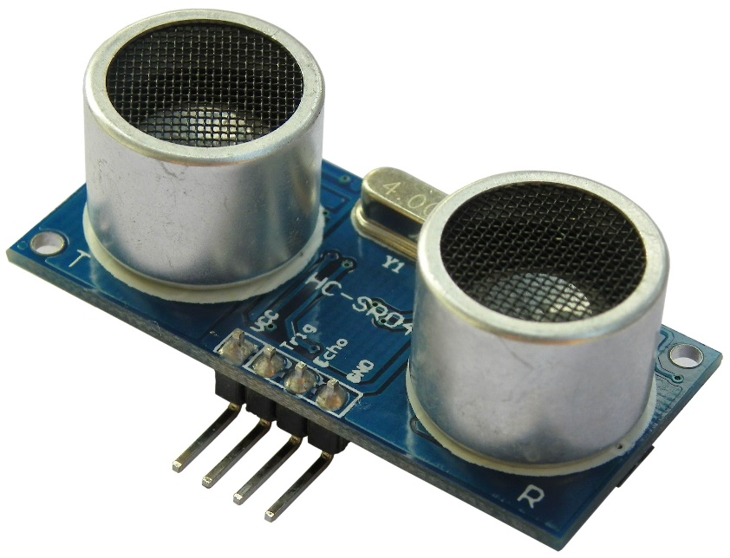
Ultrasonic Sensor: Connection
any 5v supply pin
Trigger ➔ Pin 12
Echo ➔ Pin 11
any ground pin

Slide 19
Ultrasonic Sensor: Adding Libraries
Download "NewPing_v1.7.zip"
In Arduino IDE:
Click "Sketch→Include Library→Add .ZIP Library…"
Select the downloaded "NewPing_v1.7.zip" in the file browser
This .zip includes a few example codes for you to understand the usage of the component
Click "File→Example→NewPing→NewPingExample"
Upload to try out

Slide 20
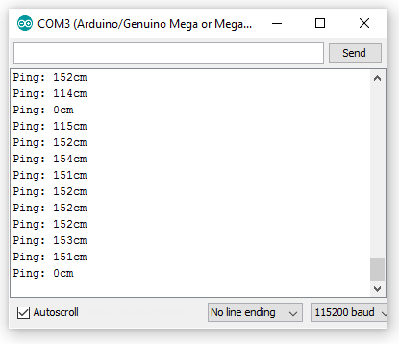
Ultrasonic Sensor: Code Example
2. Move the ultrasonic sensor around and observe the data
1. Change the baud rate
Understand the code:
Especially on how to define the pins used correctly

Slide 21
C2: Ultra-Ultrasonic Sensor….
Click "File→Example→NewPing→NewPing15sensors"
Understand the code
Connect another ultrasonic to the Arduino Mega
Use another two digital pins for trigger and echo
Modify the code accordingly to handle two ultrasonic sensors

Slide 22
Hello little car!

Slide 23
Let's build the Chassis
Follow the excellent online guide on:
How to mount the encoder kit:
https://learn.sparkfun.com/tutorials/assembly-guide-for-redbot-with-shadow-chassis/1-wheel-encoders-sik
How to mount the wheels:
https://learn.sparkfun.com/tutorials/assembly-guide-for-redbot-with-shadow-chassis/2-motors-and-wheels
The rest of the guide is not useful for us

Slide 24
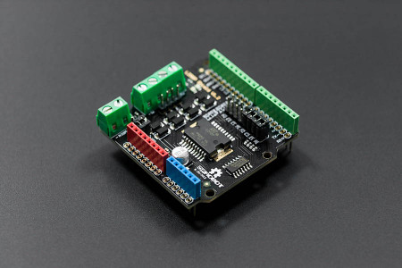
2A Motor Shield
Enable Arduino to control two DC motors:
Up to 2A current each
"Shield" == Mounted on top of Arduino

Slide 25
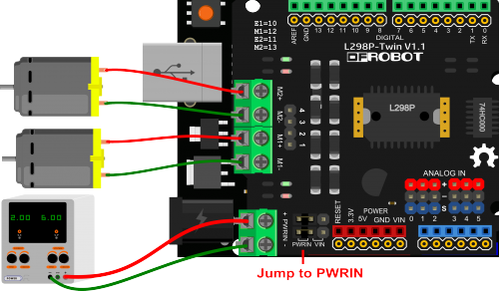
2A Motor Shield: Connection
Align the motor shield with the Arduino
Use the pin label to help
Once aligned, press down slowly
Use screwdriver to connect the motors to the 4 connection ports on the shield

Slide 26
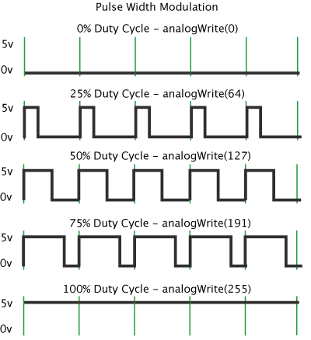
Pulse Width Modulation (PWM)
Sometimes we need to have analog output:
e.g. varying amount of power to the motor will modify the speed
PWM enables us to simulate analog output by switching on/off rapidly on an digital output channel
Pin 2 to 13, 44 to 46 supports PWM

Slide 27
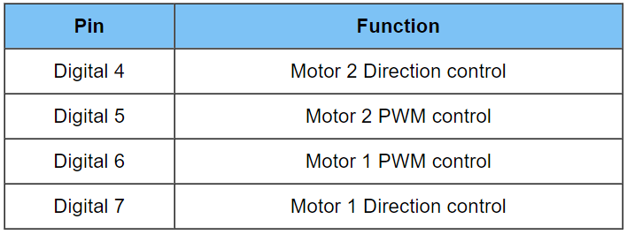
2A Motor Shield: Connection & Code
Download and run the MotorSimple.ino
Use Serial Monitor to change power level
Take note of the use of analogWrite()

Slide 28
C3: Move Like the Real Thing
Pin 4 / 7 control the turning direction (1 = clockwise, 0 = counter-clockwise) of the motors
Mount the motor shield onto Arduino and make the relevant connections
Write a program to use serial inputs for controlling the motors as follows:
'w' = move forward at full speed
's' = move backward at full speed
'a' = turn left
'd' = turn right
'x' = stop
Be Careful:
Hold the vehicle at all time!

Slide 29
External Power
Change the jumper to PWRIN
i.e. External Power Input
Connect the battery box and batteries
Use C3 to see the improved movement!

Slide 30
Interrupt
Sorry, I have to stop you!

Slide 31

Motivation
Imagine your Arduino is running some code:
However, if the external emergency stop button is pressed, you are supposed to stop processing immediately
Main question is:
How do we handle external event?
Possible solution:
Keep checking whether the event occurs, BUT this is not very efficient (time is wasted)

Slide 32
Interrupt: What is it?
Most processors provide another way to handle these events:
known as interrupt
When the external event happens:
A signal is generated
The processor automatically execute code to handle the event:
The code is commonly known as interrupt handler
After the event is handled, the processor resume the work it was performing prior to the event

Slide 33
Interrupt: Arduino Mega
Interrupt handler in Arduino Mega is known as Interrupt Service Routine (ISR)
There are 6 digital pins, each given a specific interrupt number:
Digital Pin Number | Interrupt Number
2 | 0
3 | 1
21 | 2
20 | 3
19 | 4
18 | 5
Note: the Arduino function
digitalPinToInterrupt() helps to convert pin number to interrupt number

Slide 34
Interrupt In Action: Code (1/2)
Download "ISR-Simple.ino" from IVLE folder
const byte ledPin = 13;
const byte interruptPin = 2;
volatile byte state = HIGH;
void setup() {
pinMode(ledPin, OUTPUT);
pinMode(interruptPin, INPUT_PULLUP);
attachInterrupt( digitalPinToInterrupt(interruptPin), blink, CHANGE );
digitalWrite(ledPin, state);
Serial.begin(9600);
}

Slide 35
Interrupt In Action: Code (2/2)
void loop() {
Serial.print("Working hard...");
delay(1000);
Serial.print("done. State = ");
Serial.println(state);
}
void blink() {
state = !state;
digitalWrite(ledPin, state);
}

Slide 36
Interrupt In Action: Connection
We are going to use a simple trick to "simulate" a button press / change in input for pin 2
Steps:
Upload the sketch and open the Serial Monitor.
Observe the output
Connect a male-to-male wire into pin 2. Leave the other end unconnected.
To simulate a change for pin 2, insert the other end to a ground pin and then quickly remove it.

Slide 37
Important Functions
pinMode( XXX, INPUT_PULLUP)
inverts the behavior of the pin, where HIGH means the input device is off, and LOW means the input device is on
attachInterrupt( IRNum, ISR, mode)
IRNumber: The interrupt number (NOT the pin number). Use digitalPinToInterrupt( pin ) to convert easily
ISR: The Interrupt Service Routine. The ISR should be a void XXXX() function.
mode: Triggering mode, see next slide

Slide 38
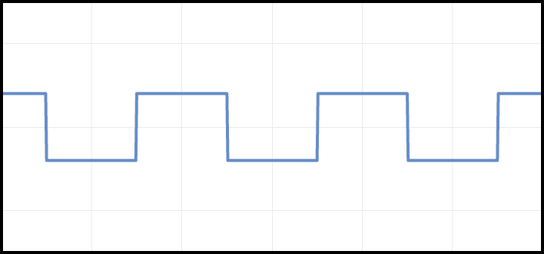
Four Interrupt Trigger Modes
Triggering Mode is based on the feature of the signal:
RISING
Triggers when the pin goes from low to high
FALLING
Triggers when the pin goes from high to low
LOW
Triggers when the pin is low
CHANGE
Triggers when the pin changes value

Slide 39
Explanation
This code demonstrates the scenario where:
the loop() is doing some work
need to react to change in pin 2 (e.g. if it is connected to a button)
How does it work?
Whenever the pin 2 experienced a change, the ISR "blink()" is executed automatically
blink() inverts the state of the LED (high➔low, low➔high)
the loop() resumes automatically after blink() returns

Slide 40
Writing ISR: Rules of Thumb
Make ISR as short as possible
Common trick: Set a flag / update value in the ISR and let the main loop to do the time consuming part
Do not use delay() in ISR
Do not use Serial read/write in ISR
If a variable is shared between ISR and other code, declare it as volatile:
Ensure correct compiler handling
Caution: When an ISR is executing, all other interrupts have to wait!
May miss important event!

Slide 41
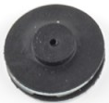
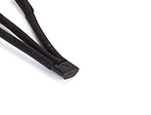
Wheel Travel Distance
Basic Idea:
If we know how many rotation a wheel make, we can deduce the distance travelled
➔We need to be able to tell when a wheel make a rotation
Use an encoder kit:
The black disc is a 8-pole magnet
The sensor on the wire uses hall-effect to convert magnetism into electric signal
sensor
8-pole magnet

Slide 42
Wheel Travel Distance: Basic Test
Let's use the ISR-Simple.ino program to get a basic understanding of the encoder
Plug in one of the sensor wires to Arduino:
Red wire ➔ any 5v Pin
Black wire ➔ any ground pin
White wire ➔ pin 2
Turn the associated wheel and observe the change of values

Slide 43
C4: How Far?
Connect the two encoder sensor wires accordingly
Write an Arduino sketch to print out the distance (in cm) moved by both wheels
e.g. "Left Distance = 100cm | Right Distance = 50cm" etc
Use Interrupt to handle the wheel rotation
Remember to keep your ISR as short as possible
You may want to focus on one wheel first

Slide 44
C5: Move with “Precision”!
Change the C3 program such that:
Forward and backward now takes two numbers S and D
S = speed setting
(1 = slow, 2 = medium, 3 = max)
D = distance to be travelled in cm
(Precision within 5cm is acceptable)
Example:
'w 2 10' = move forward using medium speed for 10cm
's 3 7' = move backward full speed for 7 cm

Slide 45
C6: Obstacle Avoidance Vehicle
Let's utilize another sensor input to guide the vehicle
Write an Arduino sketch to:
Move the vehicle forward (SLOWLY!)
When obstacle is detected in front, turn LEFT until you find a clear path
Repeat the above until your vehicle has moved 2 meters in total

Slide 46
We have a basic car at this point
Program C5 and C6 is a good starting point for subsequent working:
Make sure you spend time to improve them
You can consider combining them:
After every command, show the distance travelled for each wheel and the reading of the ultrasonic sensors

